Slide 1

WAY TO ENTERPRISE
AWS
VTI ACADEMY
Author: duy.nguyenngoc1@vti.com.vn

Slide 2
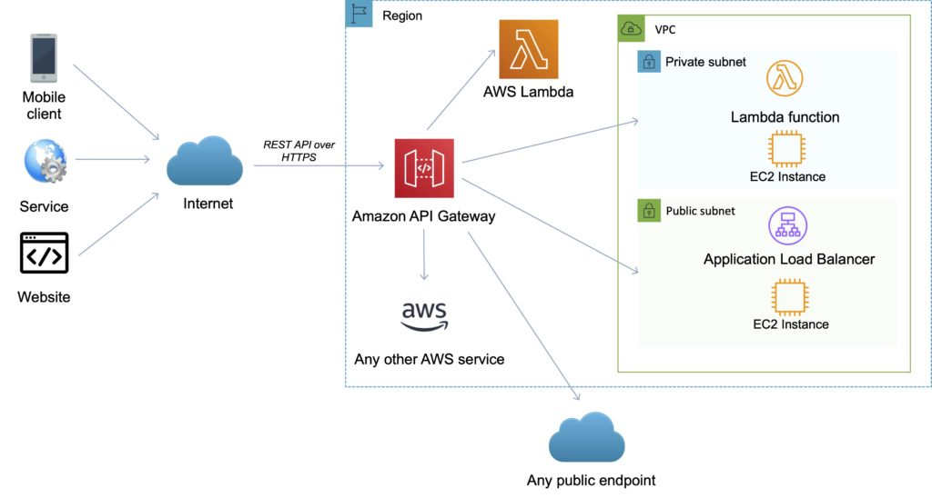
API Gateway Service
Manage APIs for
  AWS Service
  Back-end systems running on Amazon EC2
  Lambda Function
  ... any public HTTP address
Serverless Service
Price: https://docs.aws.amazon.com/apigateway/latest/developerguide/api-gateway-pricing.html
Tutorial: https://docs.aws.amazon.com/apigateway/latest/developerguide/welcome.html

Slide 3
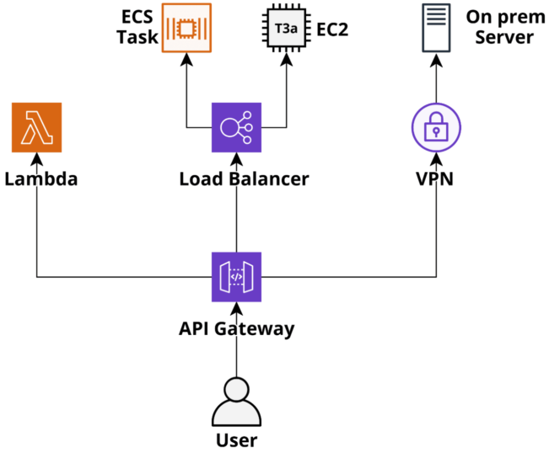
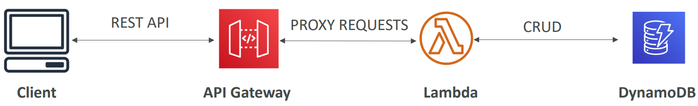
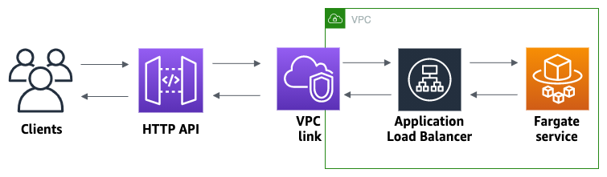
API Gateway Service
Usecases
  Accessing AWS Service
  HTTP endpoints in the backend / Restful API / Lambda Function: Support AWS API & On-premises API
  Private API: Only resources in VPC can access API Gateway
Accessing AWS Service via Lambda Function
Private API

Slide 4
API Gateway Service
Demo
  Create Lambda Function
  Create API Gateway
  Create Resource & Method in API Gateway
  Deploy API Gateway

Slide 5
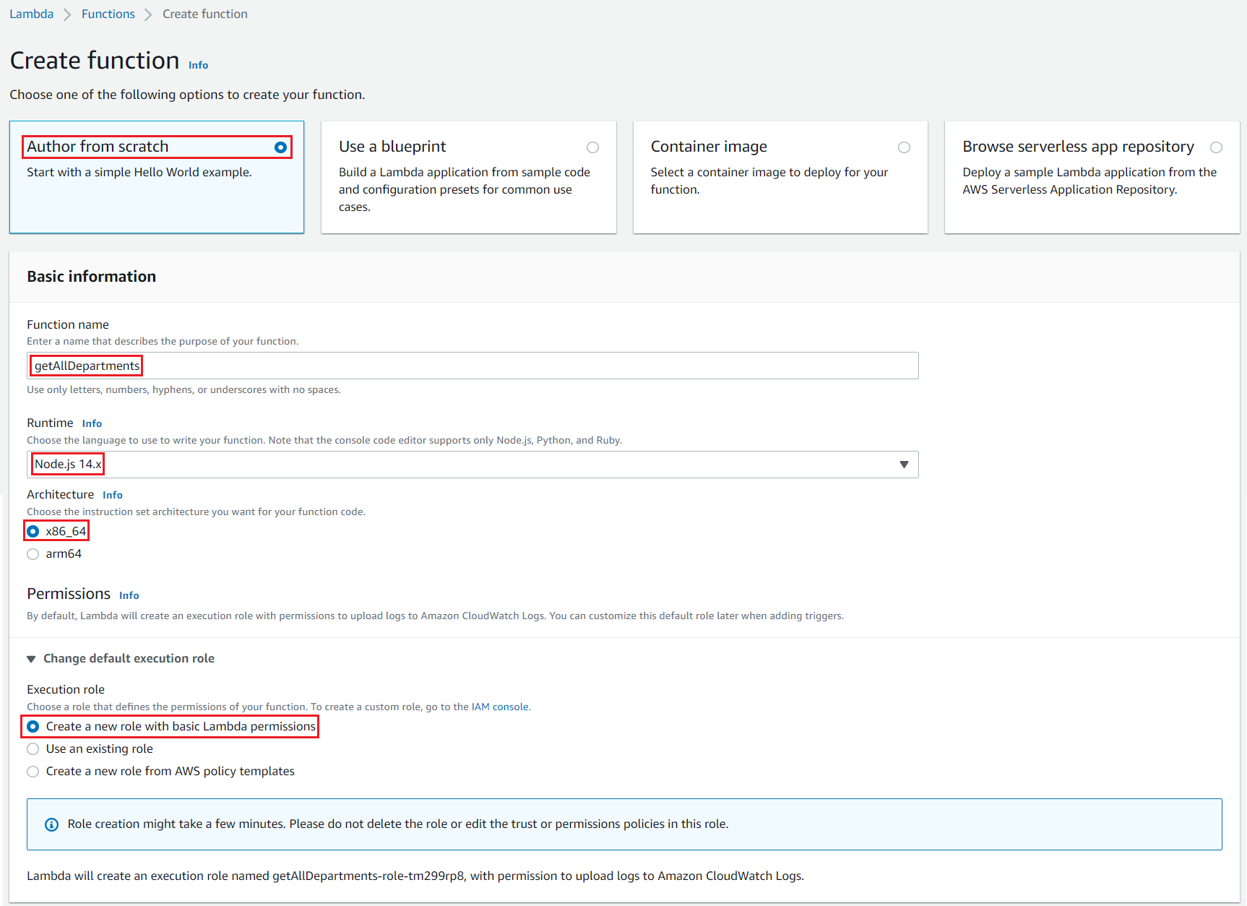
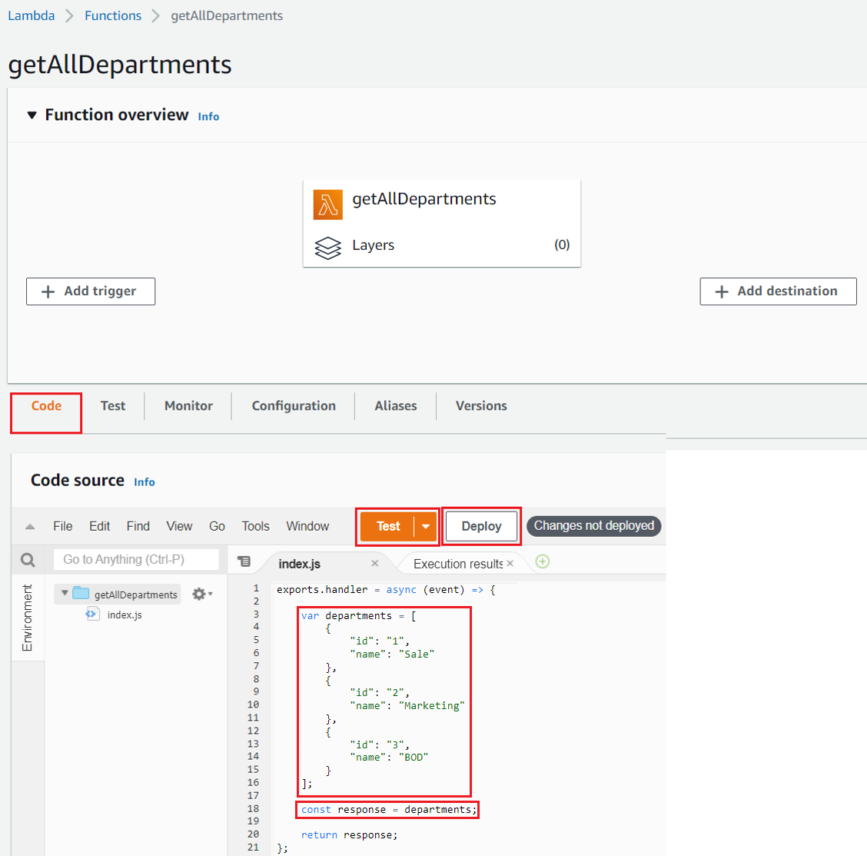
API Gateway Service
  Create Lambda Function
getAllDepartments Function

Slide 6
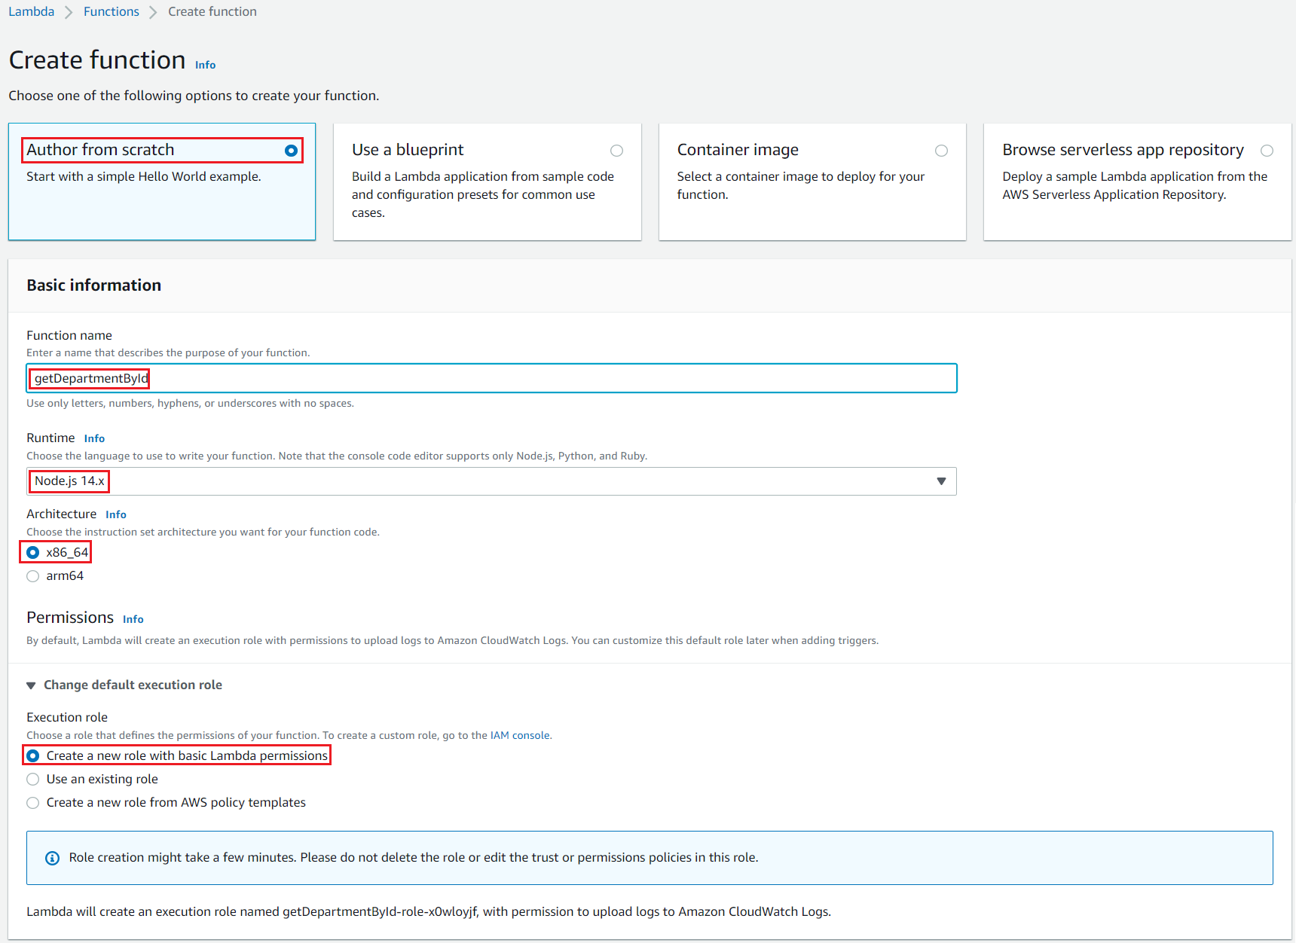
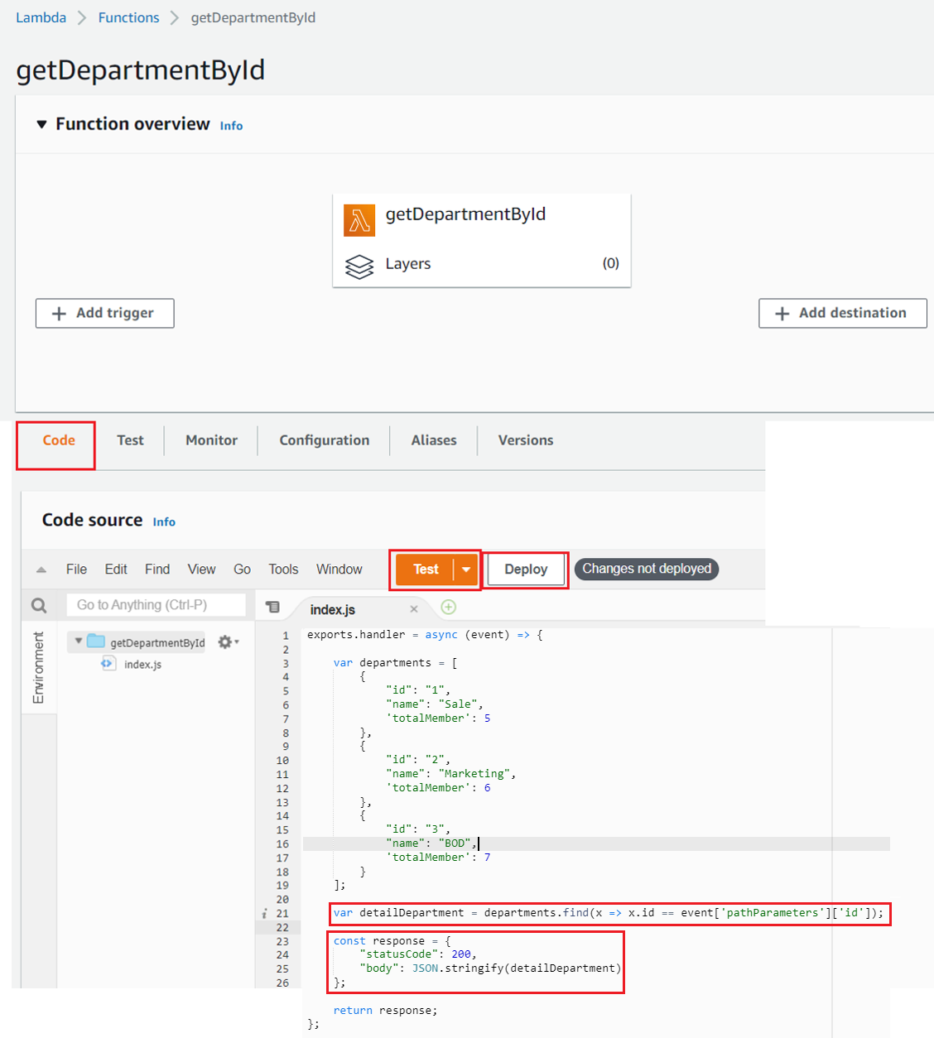
API Gateway Service
getDepartmentByID Function

Slide 7
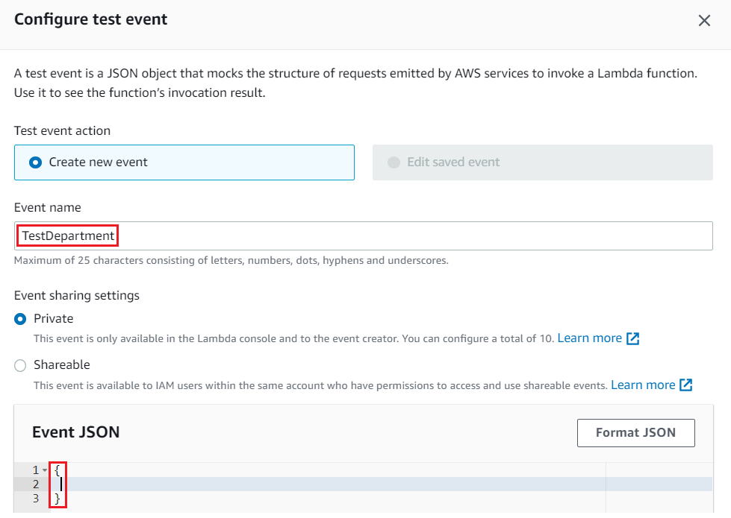
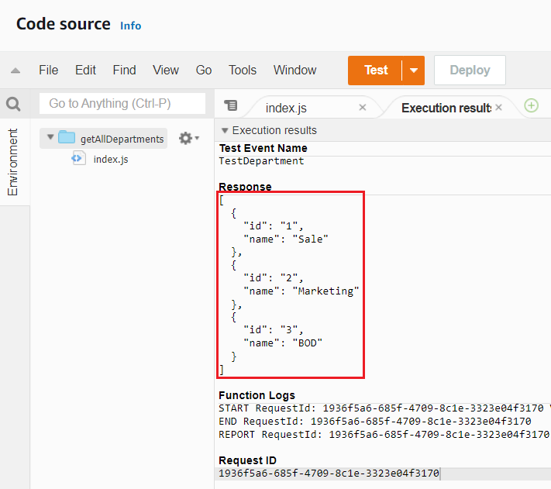
API Gateway Service
Test getAllDepartments

Slide 8
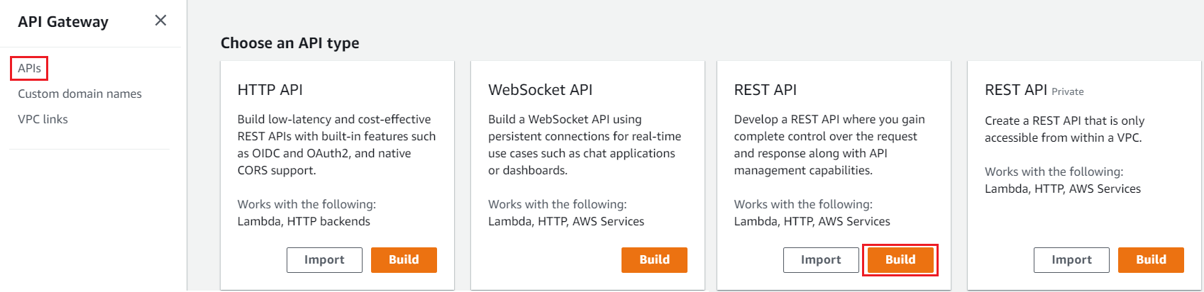
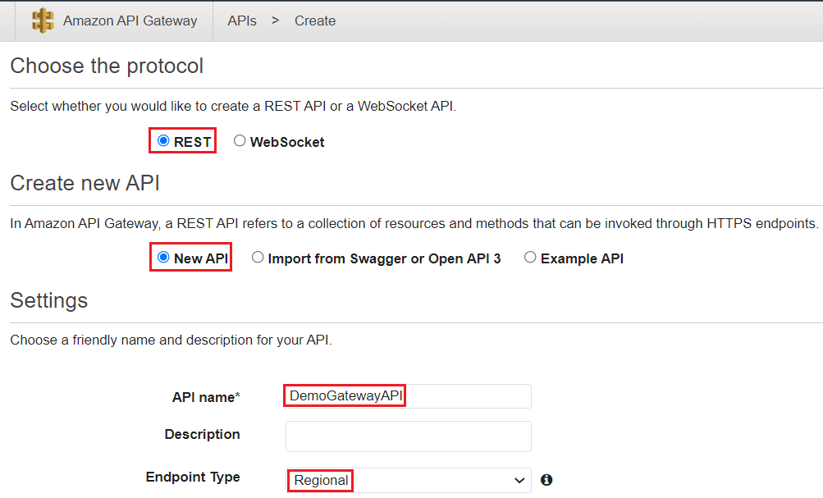
API Gateway Service
  Create API Gateway

Slide 9
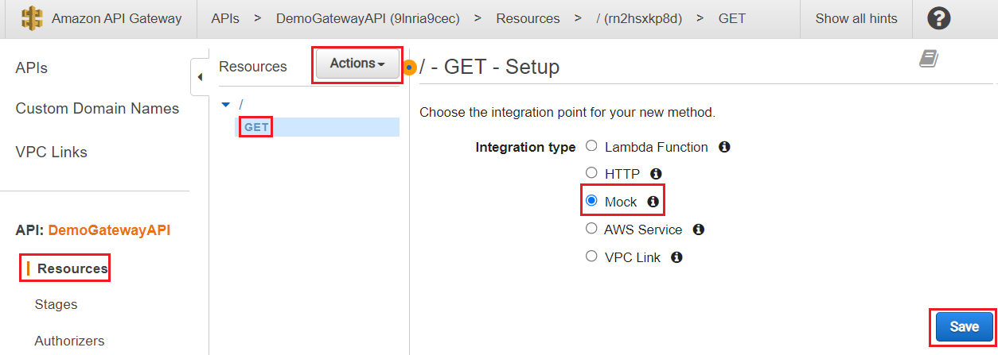
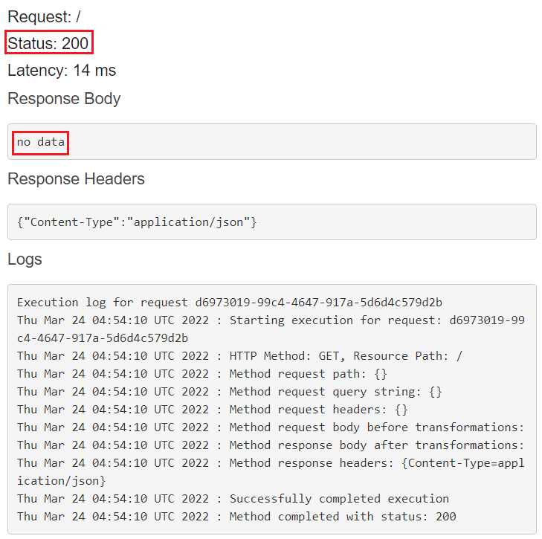
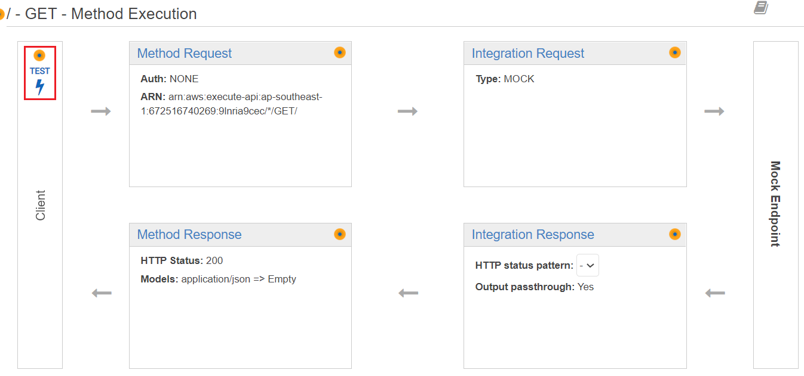
API Gateway Service
  Create Resource & Method in API Gateway
  Test
  Create method
  Link to Mock API

Slide 10
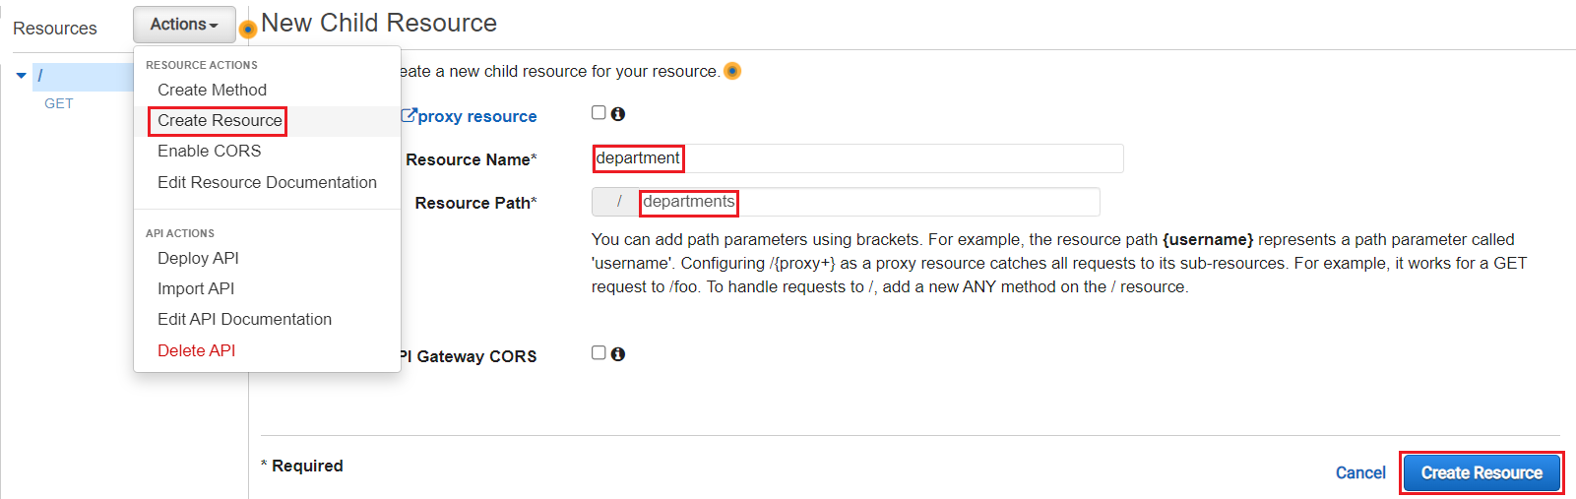
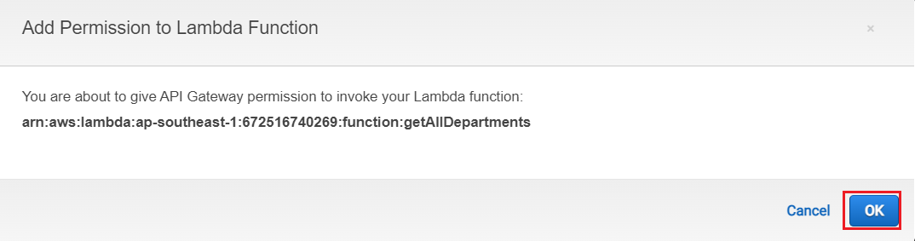
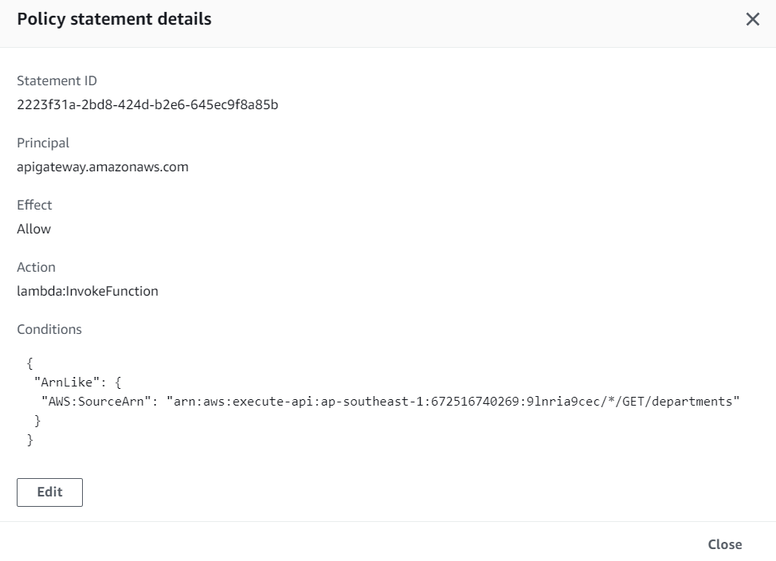
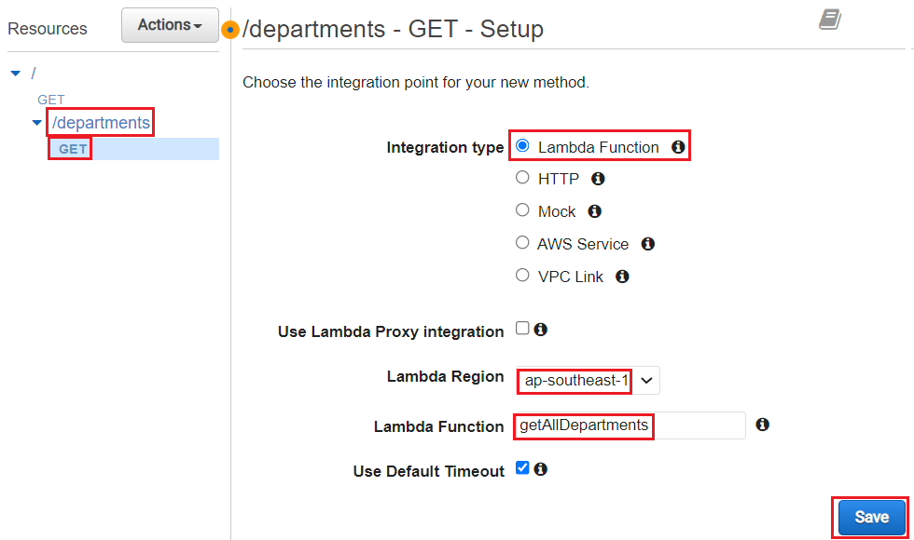
API Gateway Service
  Create resource
  Resource based Policy (Lambda Function)
  Create method
  Link to getAllDepartments Lambda Function

Slide 11
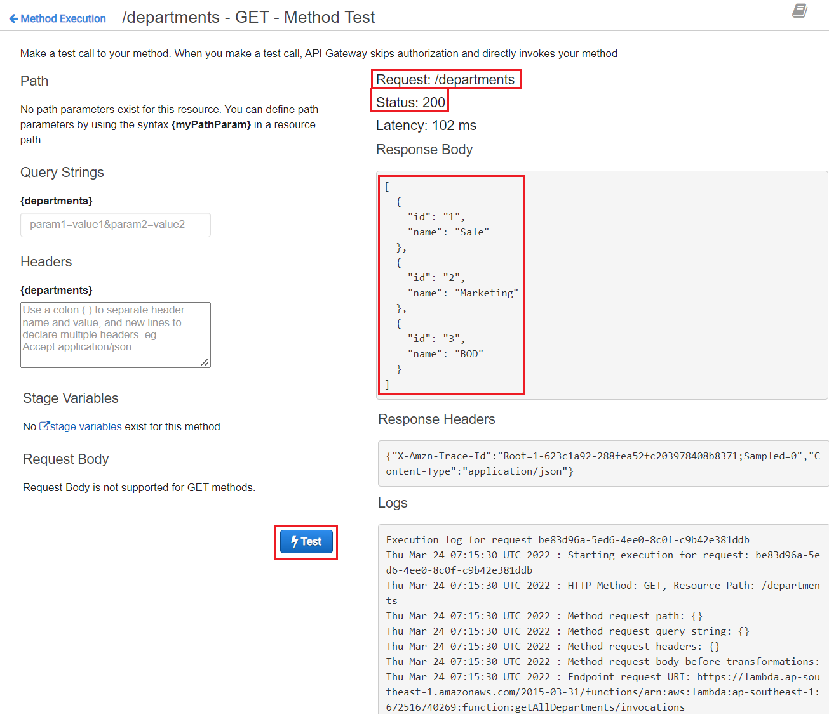
API Gateway Service
  Test

Slide 12
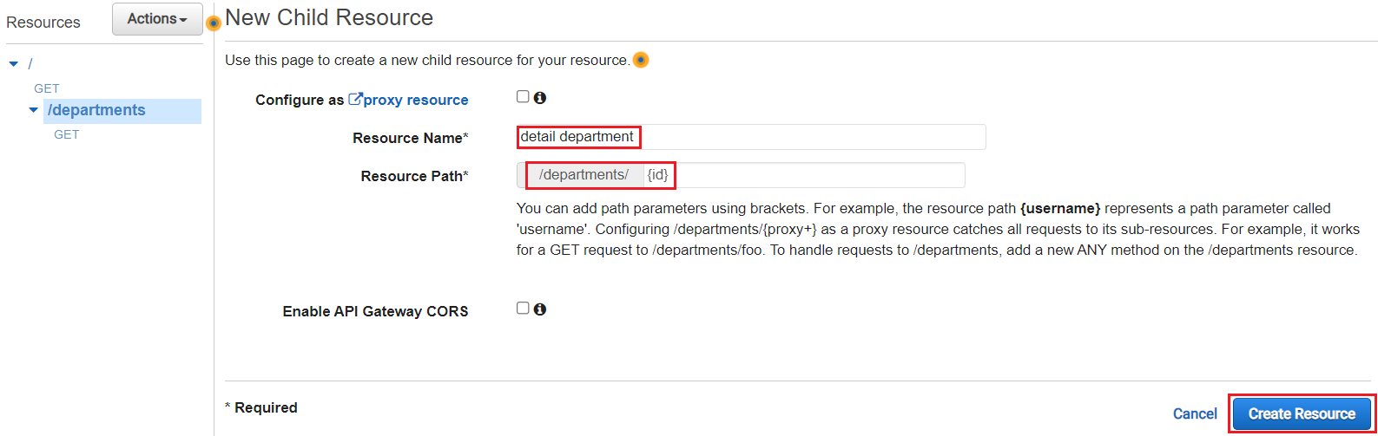
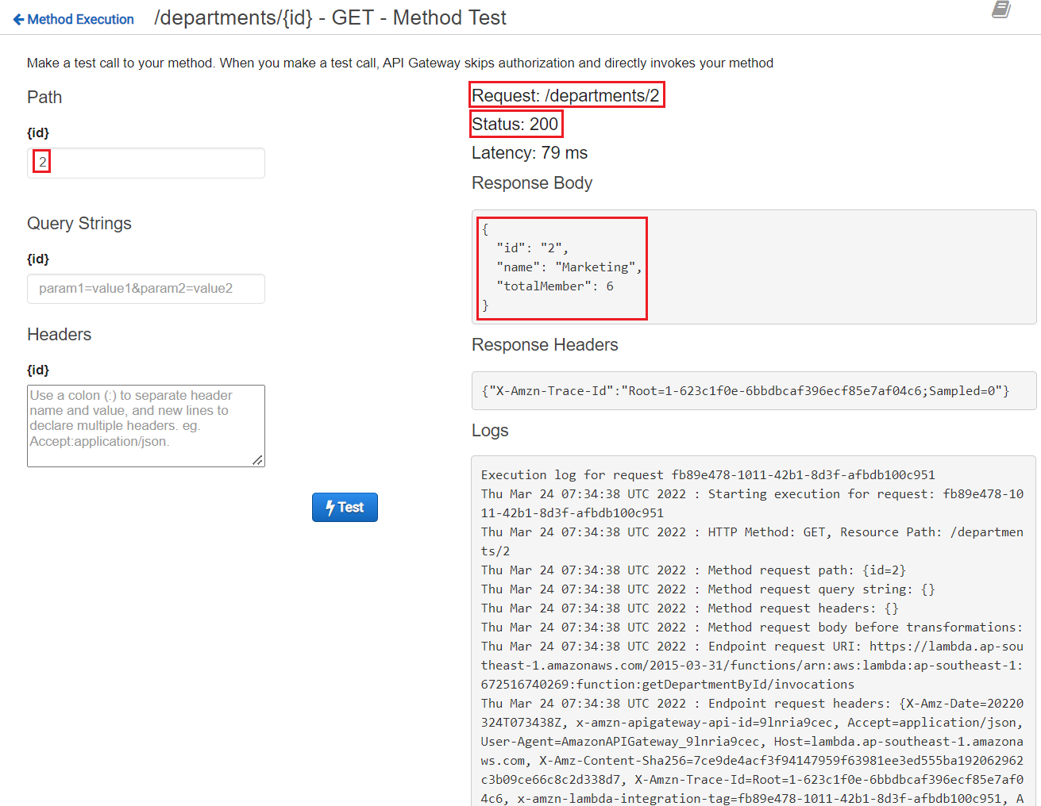
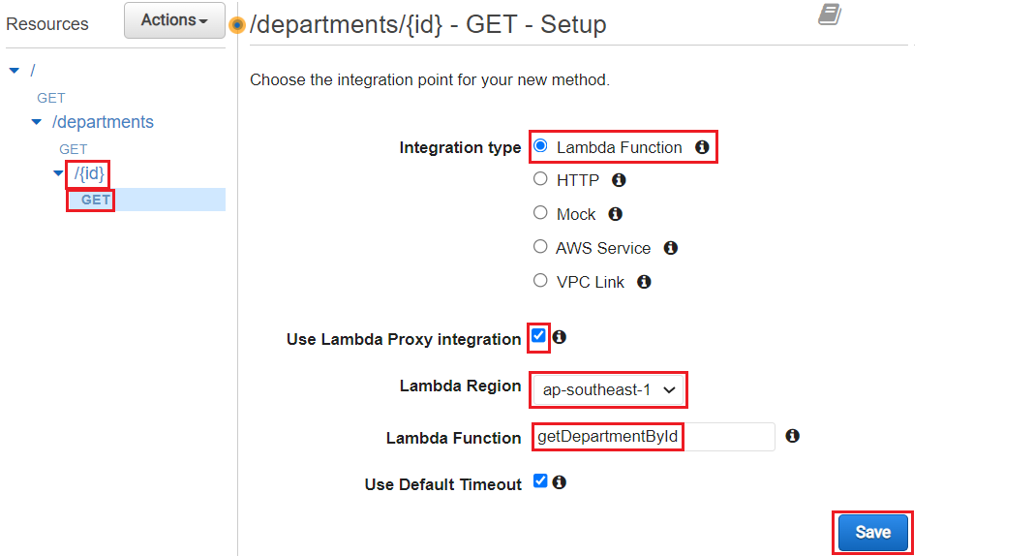
API Gateway Service
  Create resource
  Test
  Create method
  Link to getDepartmentById Lambda Function

Slide 13
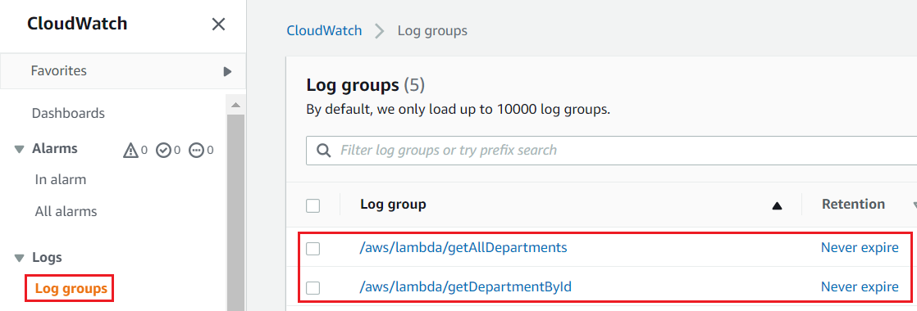
API Gateway Service
  View Log

Slide 14
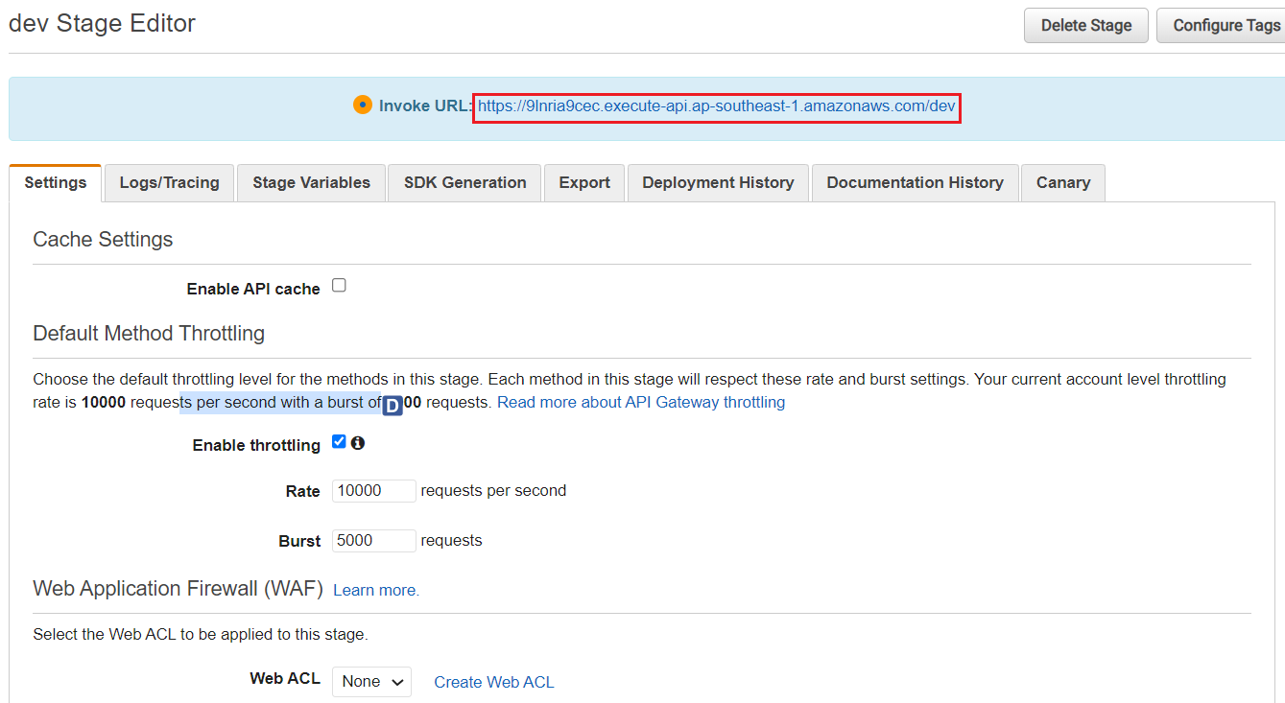
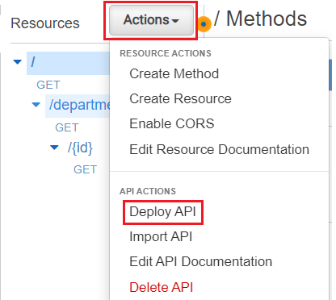
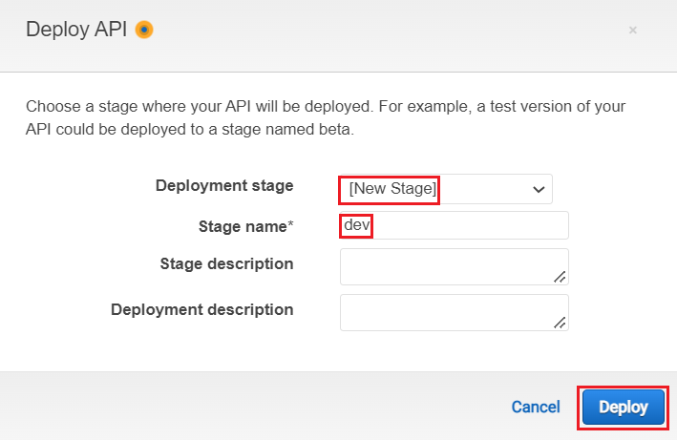
API Gateway Service
  Deploy API Gateway

Slide 15
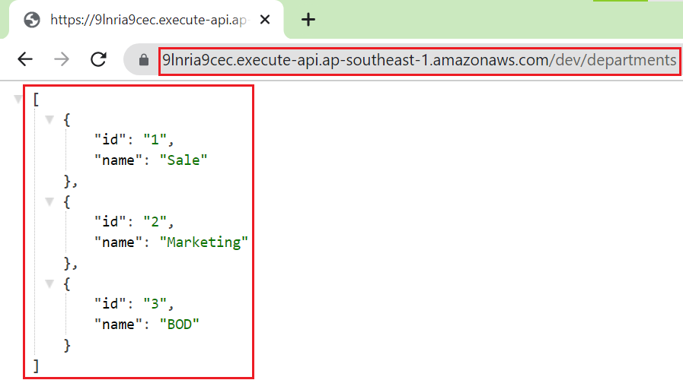
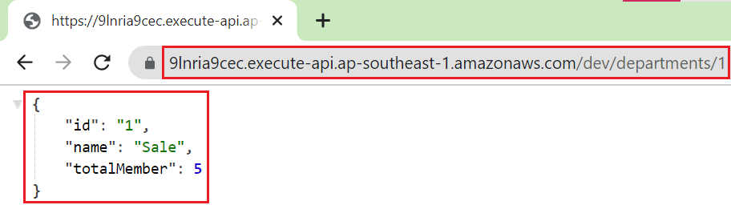
API Gateway Service
  Test
getDepartmentById
getAllDepartments

Slide 16
Assignment
  Self-practice

Slide 17
API Gateway Service
Components
  Type
  Resource
  Authorizers
  Error Response
  Stages

Slide 18
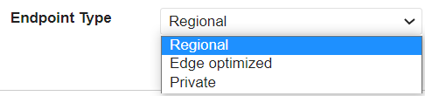
API Gateway Service
  Type
    Edge-Optimized (default): For global clients
      Requests are routed through the CloudFront Edge locations (improves latency)
      The API Gateway still lives in only one region
    Regional: For clients within the same region
      Could manually combine with CloudFront (more control over the caching strategies and the distribution)
    Private:
      Can only be accessed from your VPC using an interface VPC endpoint (ENI)
      Use a resource policy to define access

Slide 19
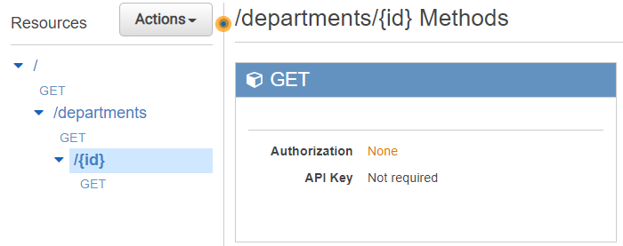
API Gateway Service
  Resources
    Config Path, HTTP method, Query String, Header, ... mapping to resources
      Lambda Function
      HTTP (API, HTTP address, ...)
      AWS Service
      VPC Link: ALB, NLB, SQS, …
    Support both Stateful API (WebSocket) & Stateless API (HTTP, REST) API
    Other config: timeout, proxy, CORS, ...

Slide 20
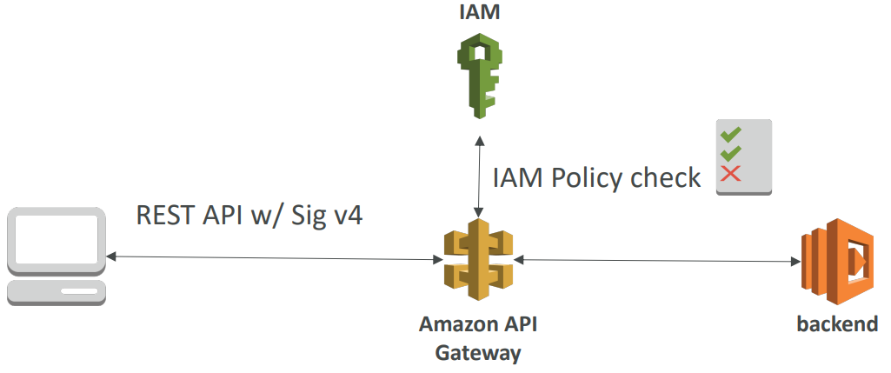
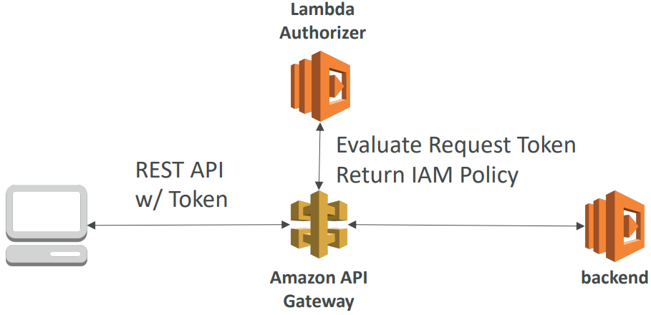
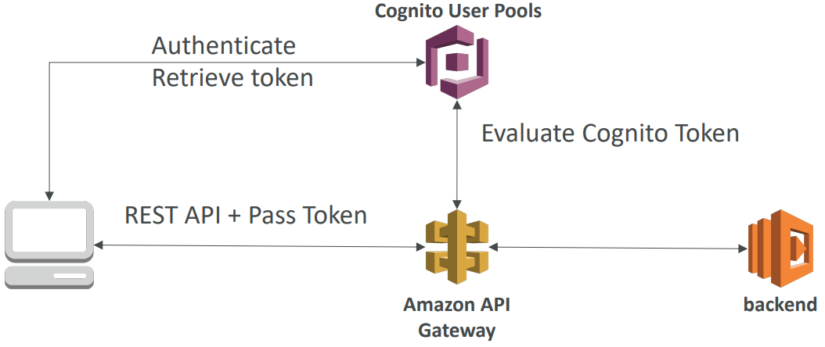
API Gateway Service
  Authorizers
    Handle Authentication & Authorization with IAM Policy, Lambda authorizer functions, Cognito user pools
IAM Policy
    Lambda authorizer functions
Cognito user pools
Demo: https://www.youtube.com/watch?v=al5I9v5Y-kA

Slide 21
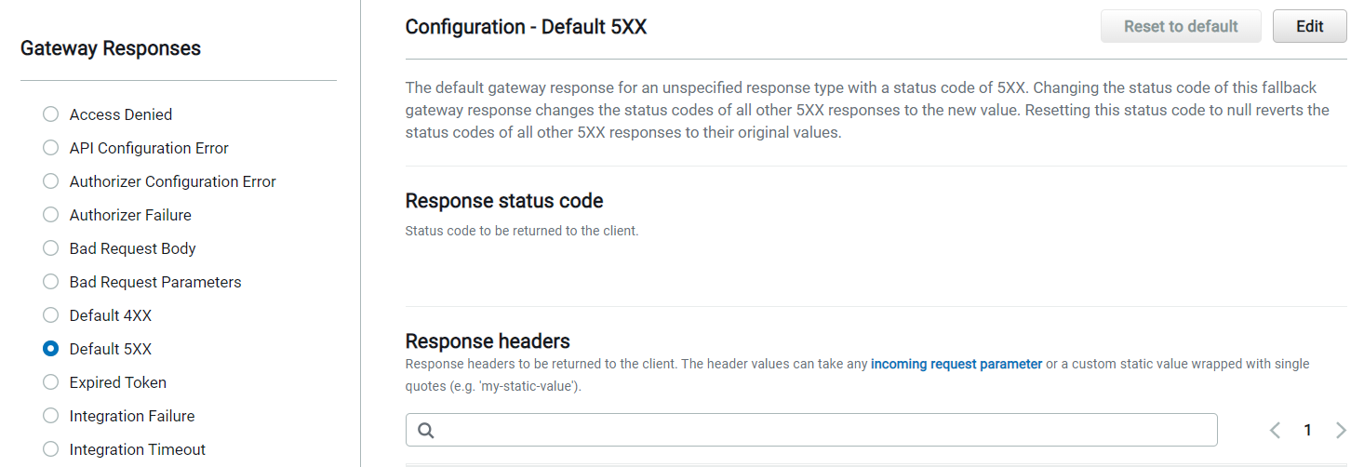
API Gateway Service
  Error Response
  Stages: dev, prod, beta, v1, v2, ...

Slide 22
API Gateway Service
Features
  Handle request throttling
  Create document for developer
  Attach API key
  Content encoding
  Import API from Swagger / Open API
  Monitoring: CloudWatch
  Transform & validate requests & responses
  Cache API responses
  Customer domain name
  WAF

Slide 23
Assignment
  Self-practice

Slide 24
Summary
Manage APIs for
  AWS Service
  HTTP endpoints in the backend / Restful API / Lambda Function: Support AWS API & On-premises API
  Private API: Only resources in VPC can access API Gateway
  Lambda Function
  ... any public HTTP address
Serverless Service
Components: Type, Resource, Authorizers, Error Response, Stages

Slide 25
Q & A
Copyright © VTI Academy All Rights Reserved

